Slide 1
Intro to Art Games
Brian Schrank DePaul University
Notes:
When we discuss art games, the more inclusive we are, the better.
Many art games question just what it means to be a game.

Slide 2
Art Games Help You Answer:
How can I grow as a designer/programmer?
How can I innovate rather than imitate?
How can I advance games as a medium?
Notes:
Art games challenge you to ask these questions
BUT you have to answer them through your
1) creative work
2) your exploration and play of other folks’ work
3) reflection on both of these

Slide 3
Talk Overview
What is Art?
Advancing an artistic medium
Formal vs. Political Art
Flow and Painting
Formal Art Games

Slide 4
Art through a populist lens
pretentious
unconvincing (in appearance)
privileged
club to bludgeon the masses
Notes:
Reaction to Modern Art: “my child could do that”

Slide 5
Art through a populist lens
“Jason Rohrer’s game, Passage, by virtue of being entirely unenjoyable as an actual game, is transparently a didactic experience about the transience of life. It is self-important and condescending. It is as if a big neon sign has lit up: ‘Pay me heed, for I am art!’”
—Edge Magazine
Notes:
Lowbrow doesn’t like middlebrow.

Slide 6
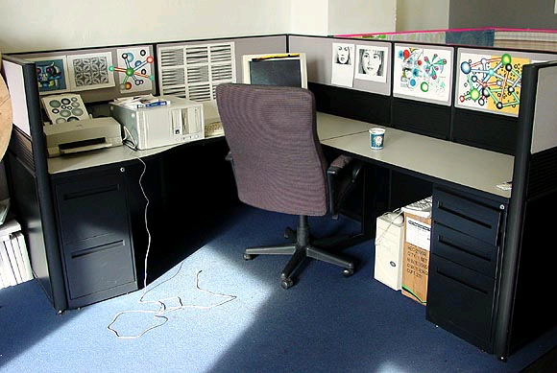
Art through a corporate/academic lens
art reduced to design
game artist = “content” artist:
model/texture/animate
characters
environments
sound effects
music

Slide 7
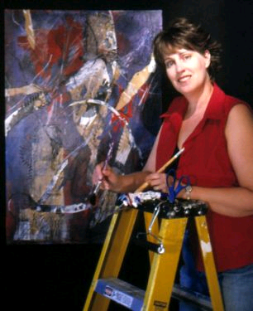
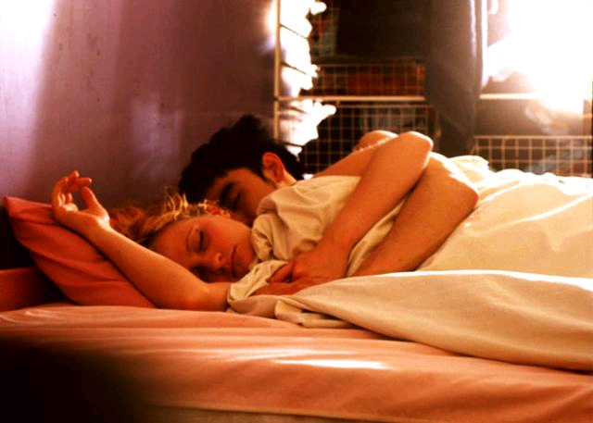
Art through a Western/scientific lens
Art is
separate,
exclusive,
specialist

Slide 8
Art through an anthropological lens…
“Art is as universal, normal, and obvious in human behavior as sex or parenting.”
—Dissanayake
Notes:
“Like other common and universal occupations such as talking, working, exercising, playing, socializing, learning, loving, and caring, art should be recognized, encouraged and developed in everyone.”

Slide 9
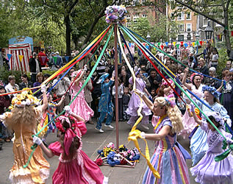
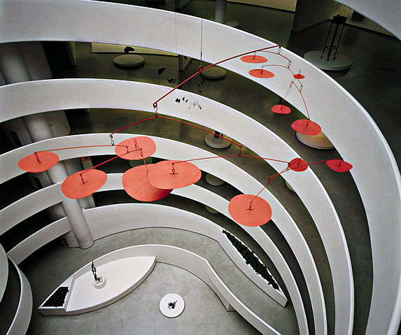
Art through an anthropological lens
Definition of art is “making special.”
Art heightens and elevates experience, making it more memorable and significant.
Art is a necessary behavior.
Notes:
fiddling around
In a protean way it is similar to how animal behaviorists describe the basic elements of play in animals
mother birds ritually fuss in shifting patterns over their baby chicks.
Make special by:
embellishing
shaping
playing
exploring
ordering
formalizing

Slide 10
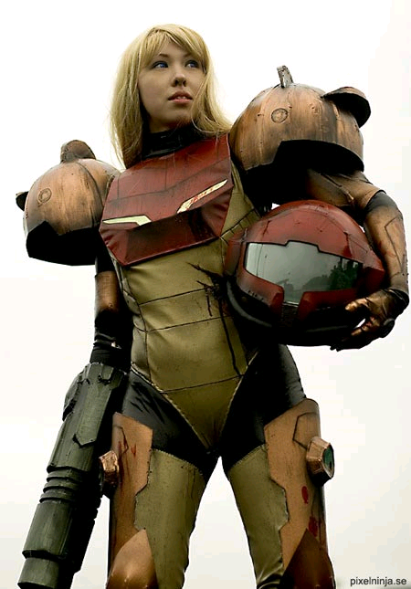
Art through an anthropological lens
Art helps disrupt other programmed responses: fight, flight, shock
Capacity to experience a transformative state
Social cohesion through social memory
Notes:
Turning events into events: marriage, harvest, festival, adulthood, war, etc
Make important objects such as tools, weapons special by transforming them from ordinary to extra-ordinary, often in ritual ceremonies
Mother-Infant bond as one of the origins of art.
Boundary of self is blurred.
Life may celebrate itself
Musical-biological
Performative (call and response)
Autopoetic, emergent rules of play
Nietzsche. Art creates the real, is most real (Reversing Plato). Art speaks Truth most vibrantly.

Slide 11
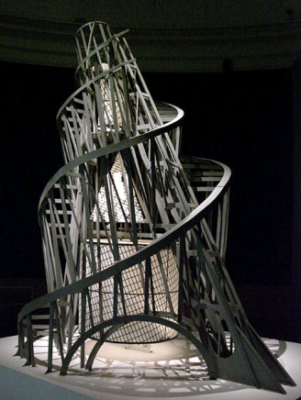
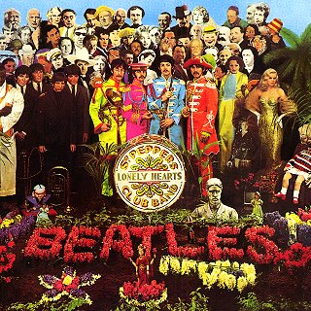
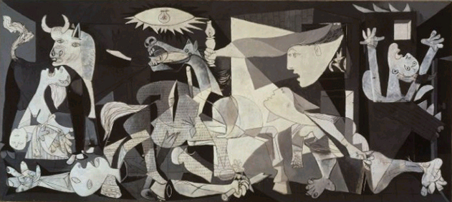
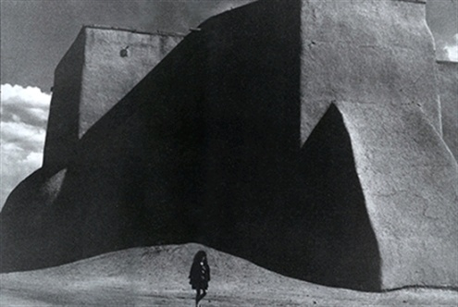
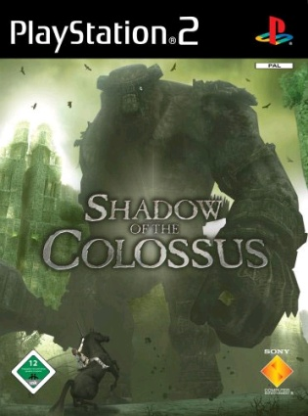
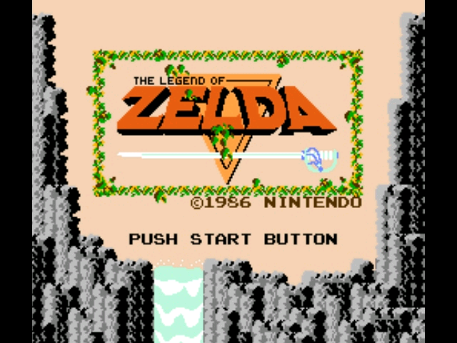
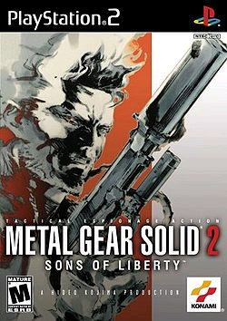
Art slide from a Jason Rohrer Talk

Slide 12
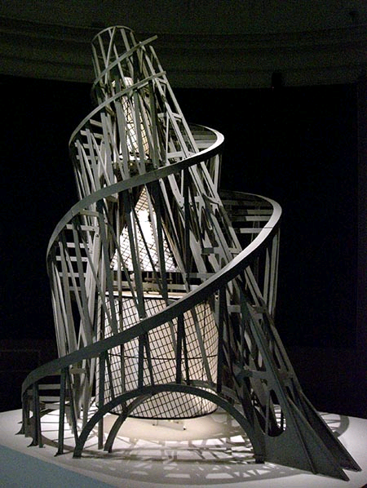
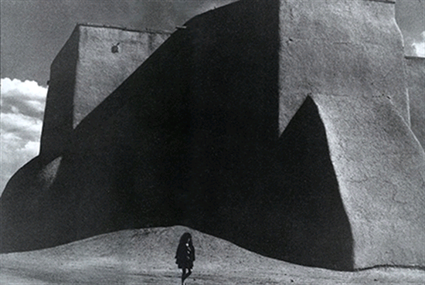
/

Slide 13
question break...

Slide 14
Alien Information Theory

Slide 15
Temple OS

Slide 16
Talk Overview
What is Art?
Advancing an artistic medium
Formal vs. Political Art
Flow and Painting
Formal Art Games

Slide 17
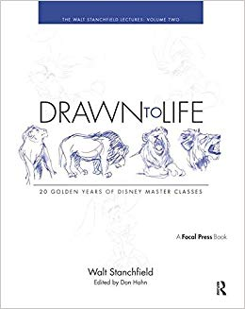
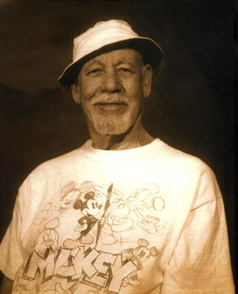
“We all have 10,000 bad drawings in us. The sooner we get them out the better.”
― Walt Stanchfield, Disney animator
Notes:
Chuck Jones, animator most famous for the Bugs Bunny character
was in Art School
"Everyone has 10,000 bad drawings in them, the sooner you get them out the better."
Foundational year
Do a lot of drawing
Accelerated Learning... artfully handicap yourself
non-dominant hand
eyes closed
Draw the exact same scene for 30 days
Playfully grief and harass your own artistic sensibility
“We all have 10,000 bad drawings in us. The sooner we get them out the better.” ― Walt Stanchfield

Slide 18
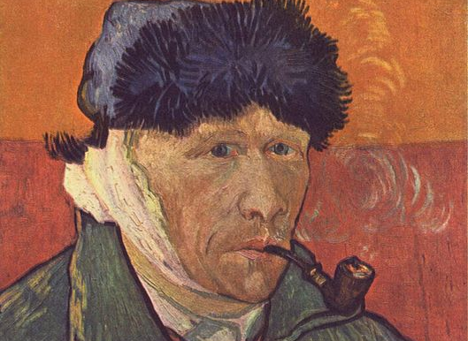
Artists and Failure
Notes:
starving artist cliche
Many artists court failure, or better put, are unafraid of failure
*Difference between art and design*
Artists may give themselves very long leashes in their work
varies from insipid and indulgent to daring and genius

Slide 19
Boundary of Art Medium
Notes:
Let’s imagine the conceptual domain and social limits of what we think a medium is.
Could be games, painting, film, dance or whatever.

Slide 20
Boundary of Art Medium
Notes:
Individual growth
Medium growth
Stabbing in the dark in non-obvious spaces
Advances in technology and commercial industry are two important factors
Artists are the infantry
rushing past the lines that we hold searching for new territories to explore.

Slide 21
New Boundary of Art Medium
Notes:
The more we look outside the box, the bigger the box can get.

Slide 22
New Boundary of Art Medium
Notes:
The medium itself changes.
Some opportunities and associations open up as others close off.
Mainstream film/TV in the 50s, 70s or 90s wouldn’t catch on as mainstream film/TV today

Slide 23
question break...

Slide 24
Talk Overview
What is Art?
Advancing an artistic medium
Formal vs. Political Art
Flow and Painting
Formal Art Games

Slide 25
Range of (Avant-garde) Art
Political
Formal
Notes:
Historically, the avant-garde has been examined from two major perspectives.
When viewed politically, the avant-garde is seen as attacking or critiquing mainstream art and culture.
When viewed formally, the avant-garde is seen as exploring the limits of the sensible, creating media beyond or at the edge of tradition.
A short-hand is the political avant-garde finds you, but you must go find the formal avant-garde.
Another short-hand is the political avant-garde manifests the “event” while the formal avant-garde creates “works”

Slide 26
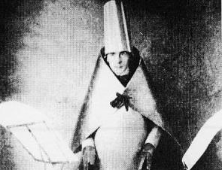
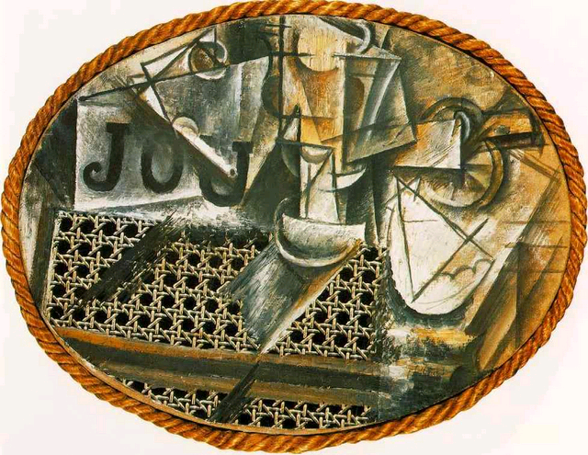
Political
Formal
Notes:
On the political side to the left, is an image of Hugo Ball as he performed the noise poem “Karawane.” Dada is an early 20th century example of art critiquing or attacking itself.
Like the Futurists, they mixed low humor with prestigious settings. For example, creating theatrical events where the performers insult the audience.
On the formal side on the right is Still-Life with Chair Caning, 1912 by Picasso. Cubism and collage is often considered the hallmark move of the historical formal avant-garde in painting. Conventions of spatial representation were deviated from and experimented with. The surface and physical material structure of painting as a medium was foregrounded.

Slide 27
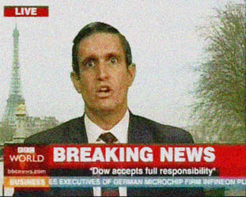
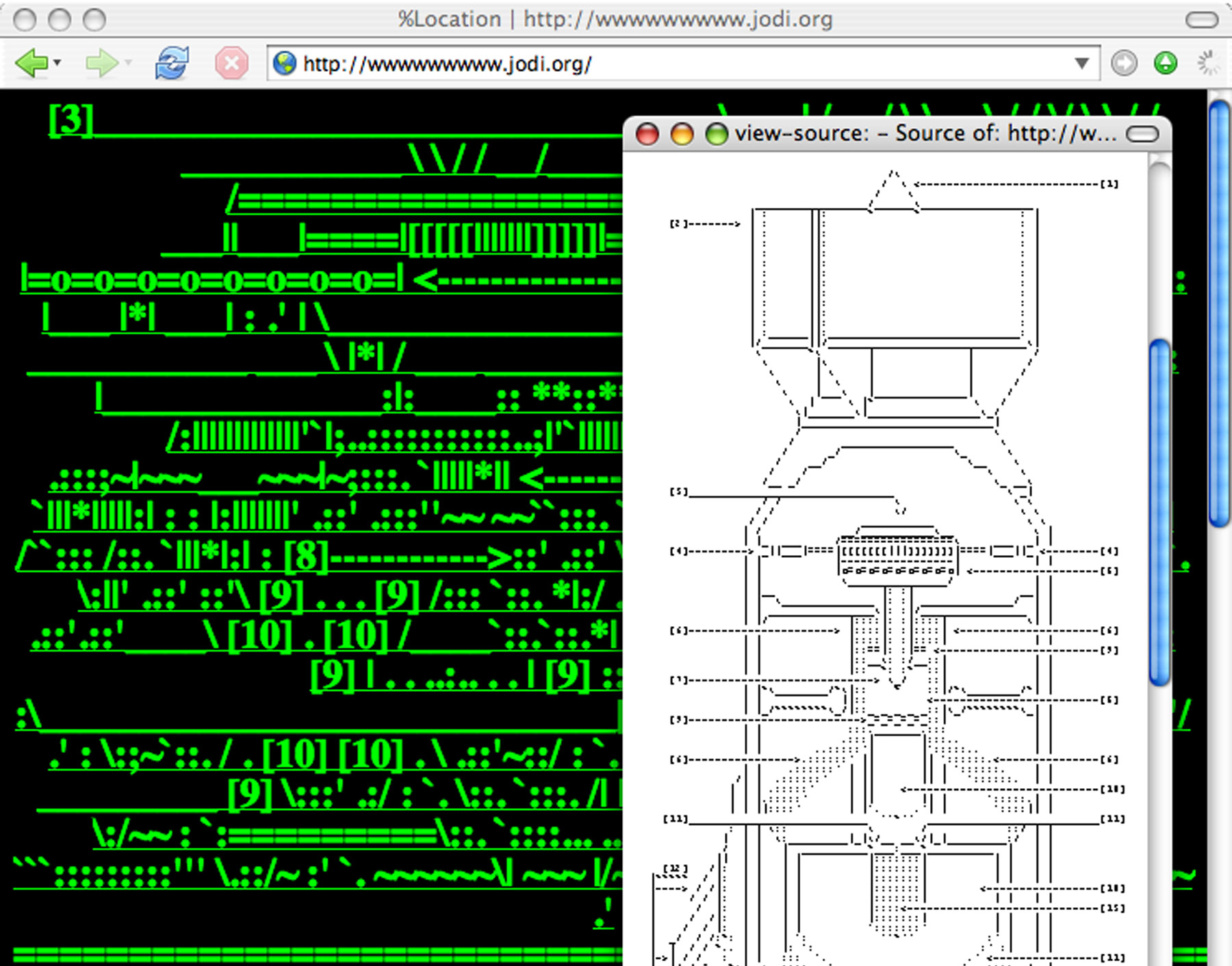
Political
Formal
Notes:
Contemporary examples…
To the political side, on the left, is the Yes Men
To the formal side on the right, is an image from a Net Art work by the artist group, Jodi. wwwwwwwww.jodi.org, 1993
Formal experiment of html code and browser parsing. When you went to the web page it was a garbled mess of links. But if you right clicked and viewed page source an asci artwork of the hydrogen bomb appeared.
Internet as a medium
Glitch aesthetics

Slide 28
Range of Art Games
Political
Formal
Magic Circle
Flow
Notes:
Here’s a way we can frame an understanding of the political and formal approaches to games.
Two key concepts in game studies are the magic circle and flow.
Political approaches to games address the magic circle
Formal approaches to games address flow
Let’s look at the role of flow in the formal approach to games

Slide 29
today we’re talking about
Political
Formal
Magic Circle
Flow
Notes:
Here’s a way we can frame an understanding of the political and formal approaches to games.
Two key concepts in game studies are the magic circle and flow.
Political approaches to games address the magic circle
Formal approaches to games address flow
Let’s look at the role of flow in the formal approach to games

Slide 30
Talk Overview
What is Art?
Advancing an artistic medium
Formal vs. Political Art
Flow and Painting
Formal Art Games

Slide 31
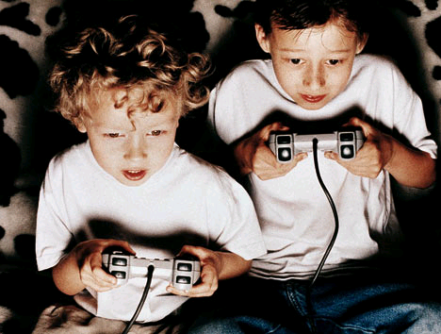
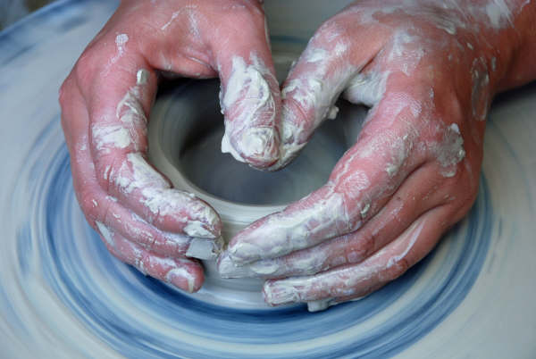
Flow: The Psychology of Optimal Experience
-Csíkszentmihályi
Notes:
Uses flow as a way to frame optimal experiences in:
Art
Games
Religion
Sports
“Flow is a sense that one’s skills are adequate to cope with the challenges at hand in a goal directed, rule bound action system
that provides clear clues as to how one is performing. Concentration is so intense that there is no attention left over to think about anything irrelevant or to worry about problems. Self-consciousness disappears.”

Slide 32
Notes:
Flow is a Popular Ideal in Videogames
Horizontal dimension is mapped to both skill level and time.
Vertical dimension is mapped to difficulty of performing in the experience.
Many successful game designers/theorists have picked up on flow and see it as a key tool in designing good games. Top right is version of the flow graph by Noah Falstein. Bottom left is one by Jenova Chen.
As a grad student studying games at Carnegie Mellon we debated about what the flow line actually looked like, and what it should look like.
It didn’t occur to us at the time to question the assumption that flow should be an ideal in the first place.

Slide 33
Notes:
The game flow uses active and dynamic difficulty adjustment.
Players determine their preferred level of difficulty in real-time. If you want more challenge, dive to a deeper level, if you want less, ascend.
This image is from Chen’s thesis on flow.

Slide 34
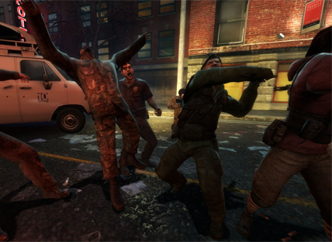
Notes:
Left 4 Dead (2008), a survival horror FPS game dynamically stages dramatic elements to control pacing.
“If you’re chewing through Infected like bubble gum, The Director will send a few Boss Infected your way…”
Valve calls the central AI agent that manages flow, “The Director,” because it as if a film director is following the player, managing the lighting, music composition, and dialogue in real-time.
Valve calls Left 4 Dead “procedural narrative,” using the exact terminology Mateas and Stern used to describe Façade.

Slide 35
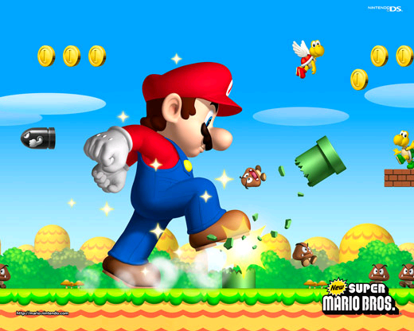
Notes:
New Super Mario Bros. game, is strongly structured according to the rules of flow. Frankly it’s a really fun game.
While it doesn’t use dynamic difficulty adjustment in real-time it still serves flow.
The challenge is crystal clear: move to the right of the screen. But there are so many delightful wrenches and power-ups thrown in to keep it challenging, but not too challenging.

Slide 36
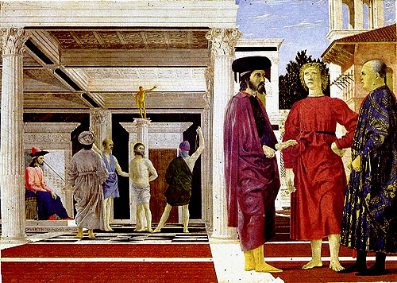
Renaissance perspective is like optimal gameplay flow
Notes:
Renaissance perspective is like optimal gameplay flow.
What does this mean?
On the left we have Flagellation of Christ, a mid 15th century painting by Piero della Francesca.
It’s strongly structured according to the rules of linear perspective.
A virtual window, it is a seamless, transparent continuation of the viewer’s world.
Techniques for reliably producing perspectival space were developed in the early Renaissance by Leon Battista Alberti in his 1435 treatise, De Pictura.
Alberti referred to the picture frame as a window and offered methodology for artists to achieve powerful illusions of depth, for example establishing the all-important vanishing point, where parallel lines converge in the distance.
Notice in Flagellation (1455–1460), how space is neatly gridded and conformed to the vanishing point in space.

Slide 37
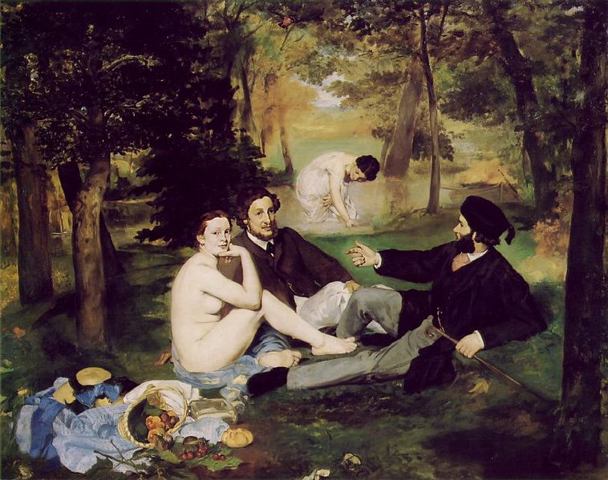
Modern painting was about the history of painting
Notes:
This is Luncheon on the Grass (1862-1863) by Manet. In the painting all the major genres of the medium were included.
Manet is considered by many to be the father of Modern painting.
He pursued what could be called, the “paintification of painting.”
The first Painting with a capital “P”
When a medium engages itself, it elevates itself.

Slide 38
Modern painting was about the playing with act of looking at painting

Slide 39
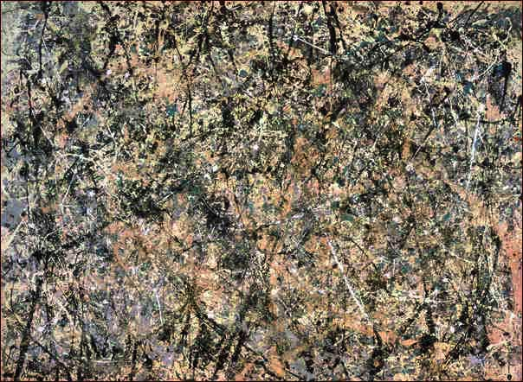
Modern painting was about the materials of painting

Slide 40
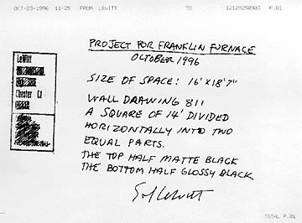
Modern painting was about the procedure of painting
Notes:
Modern artists exploded the medium of painting.
All of their moves are now popular... and obvious to us.

Slide 41
Renaissance perspective is like optimal gameplay flow
Notes:
New Super Mario Bros. is not so much a seamless continuation of the viewer’s world in terms of space.
It’s more of about maintaining a seamlessness causality.
Just as perspective guides and controls the viewer in traditional painting, common game formulas guide and control the player in a videogame by rewarding and regulating behavior along certain paths and goals.
The player and computer’s actions are locked together in time.
Minutes and hours fly by as the feedback loop is kept fluid, fun, and lubricated.

Slide 42
Formal painting plays with perspectival space
Notes:
What happened historically with painting?
The Luncheon on the Grass, by Manet
The formal avant-garde in the 19th and 20th centuries unworked traditional conventions of paintings. They questioned ideals of painting, for example, that a painting should be a virtual window.
Picasso doesn’t funnel viewers into a virtual world, to play INSIDE a perspectival space.
He allows viewers to play WITH linear perspective itself as they gaze at the surface of the painting.
Picasso doesn’t advance the rules of perspective, he re-writes them.

Slide 43
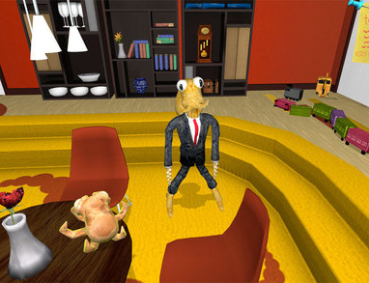
Formal games play with flow
Notes:
What happened historically with painting?
The Luncheon on the Grass, by Manet
The formal avant-garde in the 19th and 20th centuries unworked traditional conventions of paintings. They questioned ideals of painting, for example, that a painting should be a virtual window.

Slide 44
Notes:
Untitled Game (1996-2001) by the artist group Jodi,
which they created by removing a lot of code from the Quake game engine, used to make 3D FPS games.
[watch video]
Jodi doesn’t wall players inside the flow channel - to experience a world in which their actions fit perfectly.
They allow players to play WITH flow itself.
FPS conventions, such as virtual dungeon space and ferocious enemies are still there, but they are half-abstracted. The dungeon walls only half-work, and you find yourself slipping in and out of gamespace into a black void. A barking dog is somehow a colorful cube. When the player collides with an invisible trigger in space, the cube’s programmed pacing behavior is visibly disrupted as the new function is called for it to attack you. It feels like naked code, a naked design decision. If feels like the game itself is attacking you rather than one little enemy simulated inside of it.
Jodi doesn’t advance the rules of flow, they rewrite them.

Slide 45
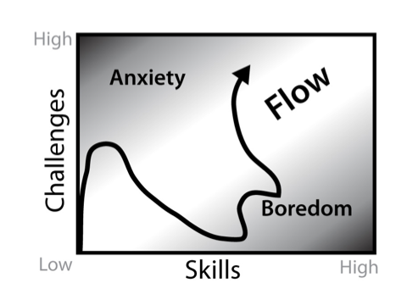
Notes:
Here is a visualization of an experience of playing Untitled Game:
You begin playing to become disoriented, frustrated, and annoyed at the apparent lack of design, or even anti-design.
As you acclimate yourself to the graphical mess you suddenly realize there is actually very little to do and you become tired of the joke.
As you tinker around with walking, shooting, looking, and exploring, you realize there is a game in there somewhere, but you have to reconstruct it to play it.
You have to do extra work to recoup it, which makes it an extra-ergodic videogame.
Realizing that it is oddly playable causes another big spike in anxiety as you roll up your sleeves and dig back into the work.
What the player has been doing the entire time is attempting to reconstruct the walls of the flow channel that were removed by Jodi. This removal becomes literal in the fact that Jodi created Untitled Game by removing large chunks of code from the Quake game engine.
The result forces people to play WITH flow rather than play IN the flow.

Slide 46
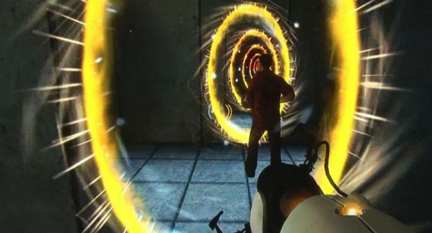
…contrast with a mainstream game like Portal
Notes:
It is worthwhile to contrast Untitled Game to a mainstream game that simply plays with your mind.
In the FPS game Portal, spatial continuity, physical forces, and the narrative itself become twisted in an exquisitely designed, witty mind-bending puzzle.
It is expected that the game will play tricks on you, but also that the tricks are meant to be solved.
Untitled Game is not about solutions but the tricks themselves, about exploring the qualities of those tricks of collision, enemy logic, ballistic logic, health meters, power ups and so on. It is not less of a game than Portal, if anything it is more of a game because it allows players to investigate the buried, intuited structures that make flow possible.

Slide 47
Notes:
Let’s look at one other crazy formal game.
Jeff Minter, founder of Llamasoft, is known in the game community for his absurdist, psychedelic games he’s made since the early 80s. Let’s look at Space Giraffe for the Xbox 360 and PC.

Slide 48
Reviews of the Game:
“…it’s so atypical and requires so much effort to appreciate that very few will find it truly worthwhile.”—Games Radar
“With incredibly poor visibility (apparently by design) and a thumping electronica soundtrack, it offers a generous 100 levels of damn-near-unplayable technoslop.”
—Official Xbox Magazine

Slide 49
Notes:
[watch video]

Slide 50
Notes:
Jeff Minter explains:
[read quote]
The game is flowing, overflowing really, it appears to be having a lot of fun.
You feel left out, as if you’re missing the most important things.
Then of course, the nausea sets in.
It is worth noting that Space Giraffe, like Untitled Game, is in dialogue with the mainstream game industry’s fixation on graphics and logical Cartesian space.
Both of these works investigate that fixation but from opposite directions.
Untitled Game launches a directly critical tactic—it breaks the graphics engine to get its moiré patterns and noise.
Space Giraffe uses an absurdly excessive tactic—it doesn’t break the graphics card, but the contrary—
it successfully juices so much performance from it that it ends up parodying itself, in a campy digital firework show.
For its effects, the game uses Neon, the default music visualizer for the Xbox 360, which was built by Minter himself.
Where Jodi formally interrogates the medium from outside the game industry—they are mostly known as internet artists—Minter formally interrogates it from its core.

Slide 51
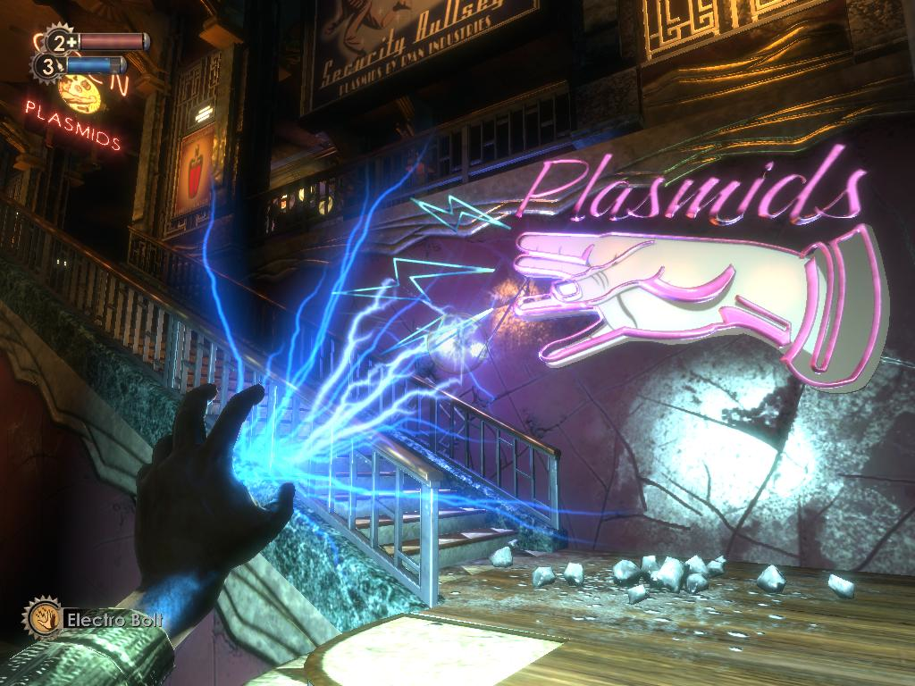
Notes:
Almost all games use visual spectacle
Space Giraffe deviates from these in an obvious way. In popular, visually stunning games, such as Bioshock, the spectacle is at the service of the player’s desire. The visuals are meant to awe and seduce the player into feeling immersed, present and empowered in the virtual world.

Slide 52
Formal games explore this space:

Slide 53
question break...

Slide 54
Talk Overview
What is Art?
Advancing an artistic medium
Formal vs. Political Art
Flow and Painting
Formal Art Games

Slide 55
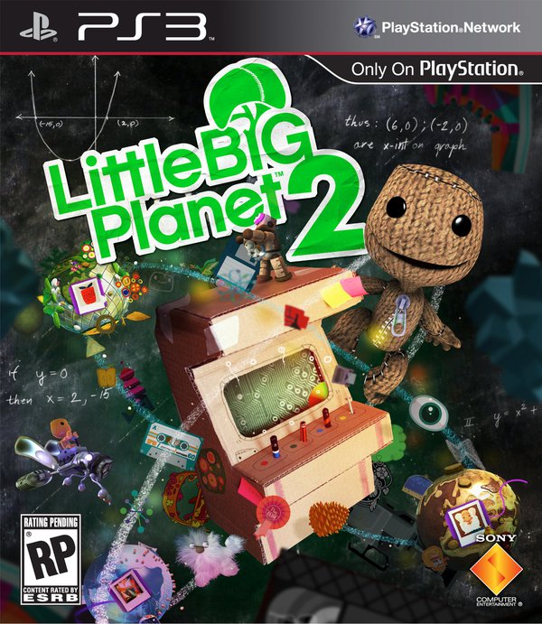
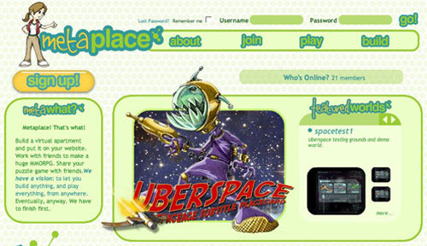
Formal games can be about making & sharing games
Notes:
These might not be high art.
However, even in the mainstream space formal games can advance the medium.

Slide 56
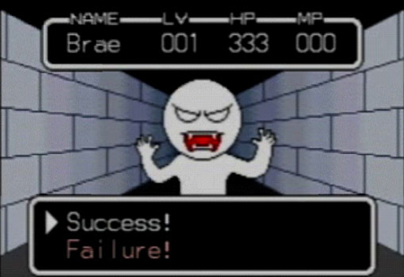
Formal games about the history of games
Notes:
history of Nintendo games, to be precise

Slide 57
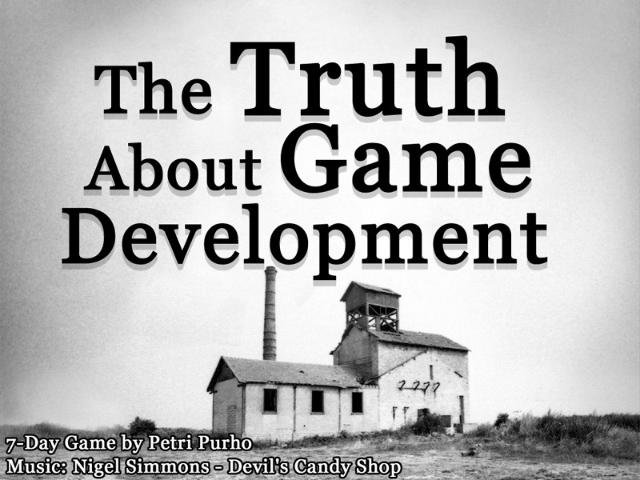
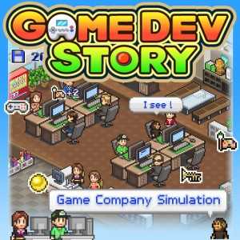
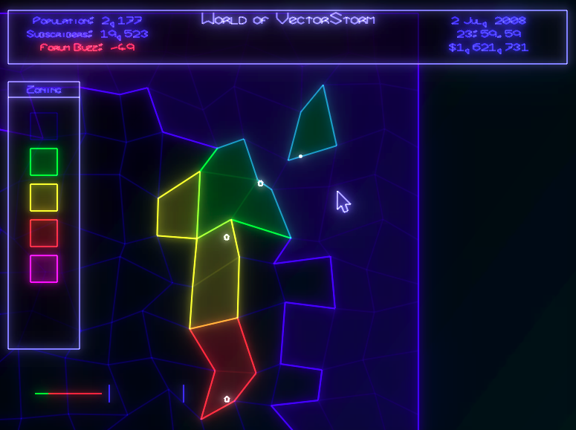
Formal games about game development

Slide 58
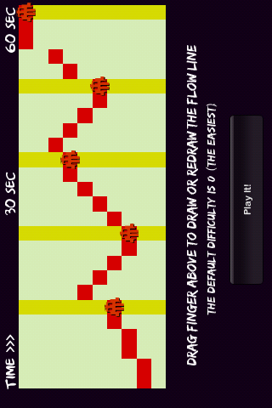
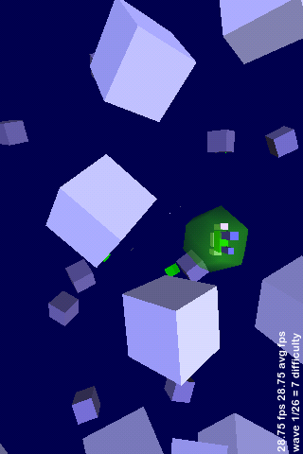
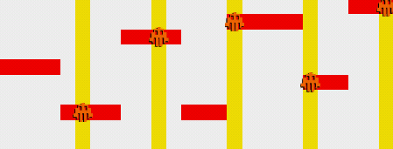
Formal games about game design

Slide 59
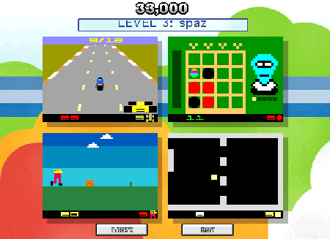
Arcadia is about game genres & mechanics
Notes:
play 4 games at once.
describe experience of switching gameplay modes across the 4 screens

Slide 60
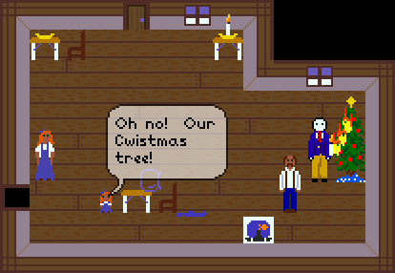
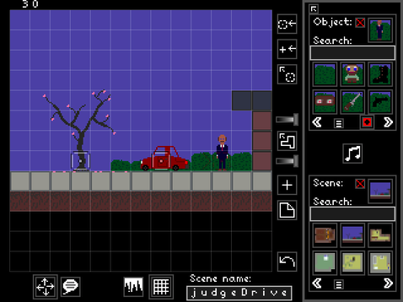
Sleep is Death is about improvisational game design

Slide 61
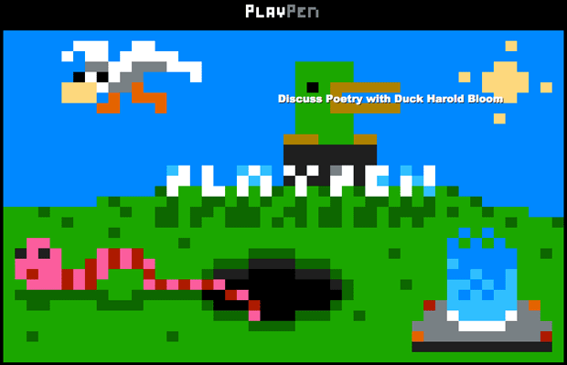
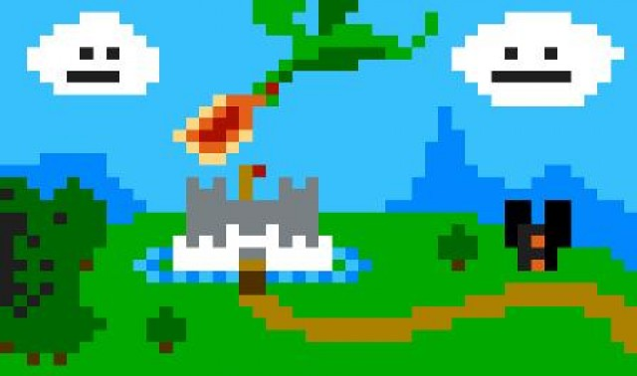
PlayPen is about wiki-like, collaborative game design

Slide 62
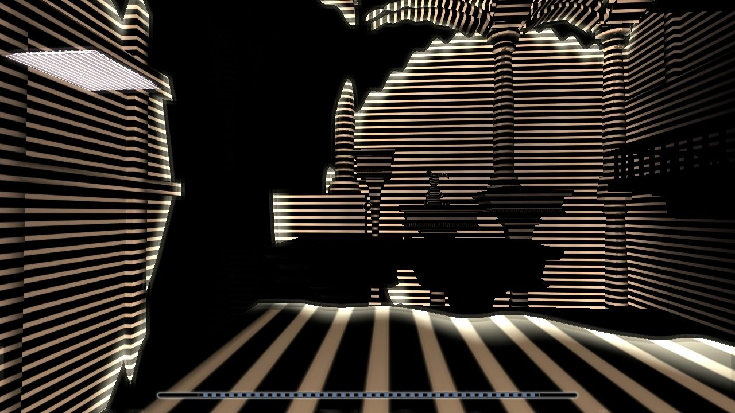
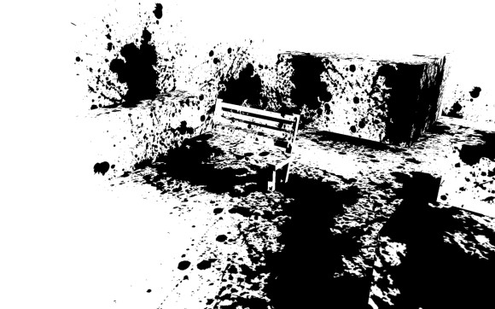
Formal games about navigating and rendering 3D space
Notes:
Devil’s Tuning Fork
Unfinished Swan

Slide 63
Super Mario Clouds is about game nostalgia & hardware
Notes:
Super Mario CloudsImages of Gallery exhibit and website
High Art and DIY culture
Minimal aesthetics and getting your hands dirty and dusty, breaking apart cartridges
Returning to childhood memories with adult skills and sensibilities, the ability to reflect and be critical

Slide 64
These games gamify games. That is why they are formal. They primarily play with the form of the medium.

Slide 65
Formal games establish and expand the artistic domain games.
Notes:
It can actually counteract the dumbing down of games that we get through gamification as marketing.
As gamification by itself reduces games to point systems, skinner boxes, and so on, games about games show us so much more of the medium that is overlooked in these simplistic approaches.

Slide 66
Questions?

Slide 67
if there’s time, review more formal games listed with Resources on class website: http://artgamedev.com/resources.html

