Slide 1
High Art versus Low Art from film, video, and games
Art Games
Schrank

Slide 3
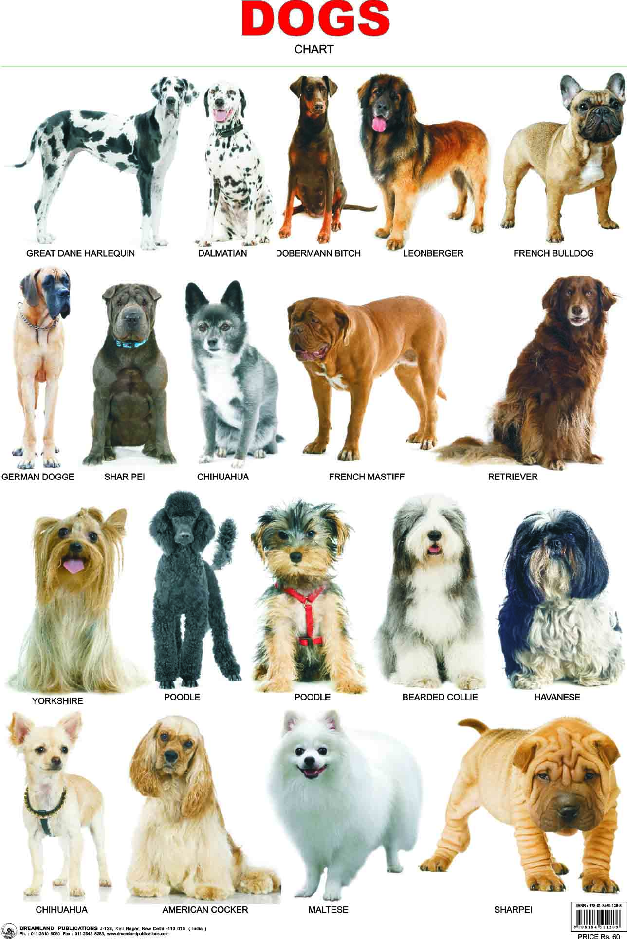
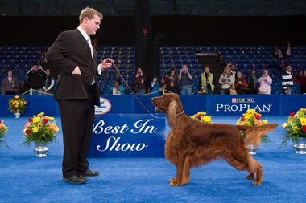

Slide 4
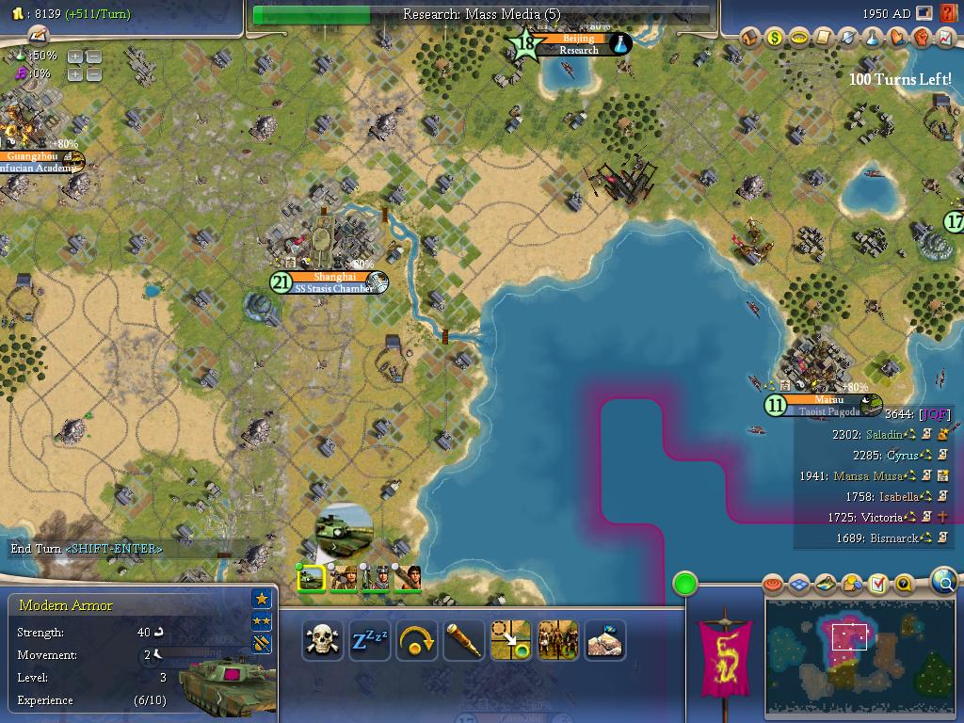
It is okay to LOVE things that don’t advance culture. Why so sensitive?

Slide 5
Avant-garde (High Art)
Hierarchy of Film
T, O, U, C, H, I, N, G, Empire, Window Water Baby Moving
Holy Mountain, Meshes of the Afternoon
The Comedy, Spring Breakers
Tree of Life, Enter the Void, Lost Highway
Her, Lost in Translation, Lord of the Rings
Transformers, War Horse, The Hobbit
most porn
propaganda
Kitsch (Low Art)

Slide 6
Avant-garde (High Art)
Hierarchy of TV/Video
Technology/Transformation: Wonder Woman, Vidéo Tango
The Cremaster Cycle, Andy Kaufman’s work
Tim & Eric, The Eric Andre Show
Game of Thrones, Breaking Bad, Eagleheart
Walking Dead, Adventure Time
SNL, The View, Scrubs, Two and a Half Men,
most porn, commercials
propaganda, the news
Kitsch (Low Art)

Slide 7
Avant-garde (High Art)
Hierarchy of Games
Untitled Game, Patriotic Nigras, Gazira Babeli
The Intruder, Mondo Agency, Standard Bits
Façade, Passage, Super Columbine Massacre RPG!
Ds4ia, Nidhogg, Braid, some porn games
Stanley Parable, Hotline Miami, Antichamber
Last of Us, Halo, Super Hexagon, Civilization
casual games (Candy Crush), serious games
advergames, propaganda (America’s Army)
Kitsch (Low Art)

