Slide 1
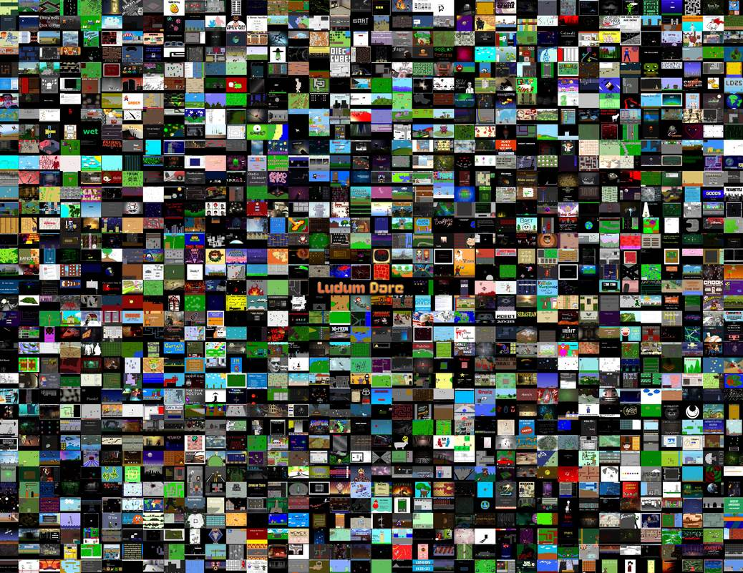
Games as Art and Entertainment: Towards More Inclusive Cultures
Southwest Popular / American Culture Association February 8, 2018
Brian Schrank, PhD
Author of Avant-garde Videogames from MIT Press
www.BrianSchrank.com

Slide 2
Overview of Game Communities
Folk
Indie
Mainstream
[Populist] High Art
High Art
Avant-garde

Slide 3
Overview of Game Communities
Folk
Indie
Mainstream
[Populist] High Art
High Art
Avant-garde

Slide 4
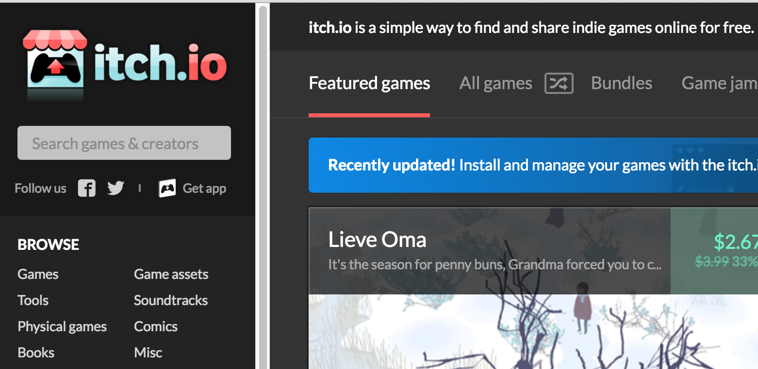
Folk Community

Slide 5
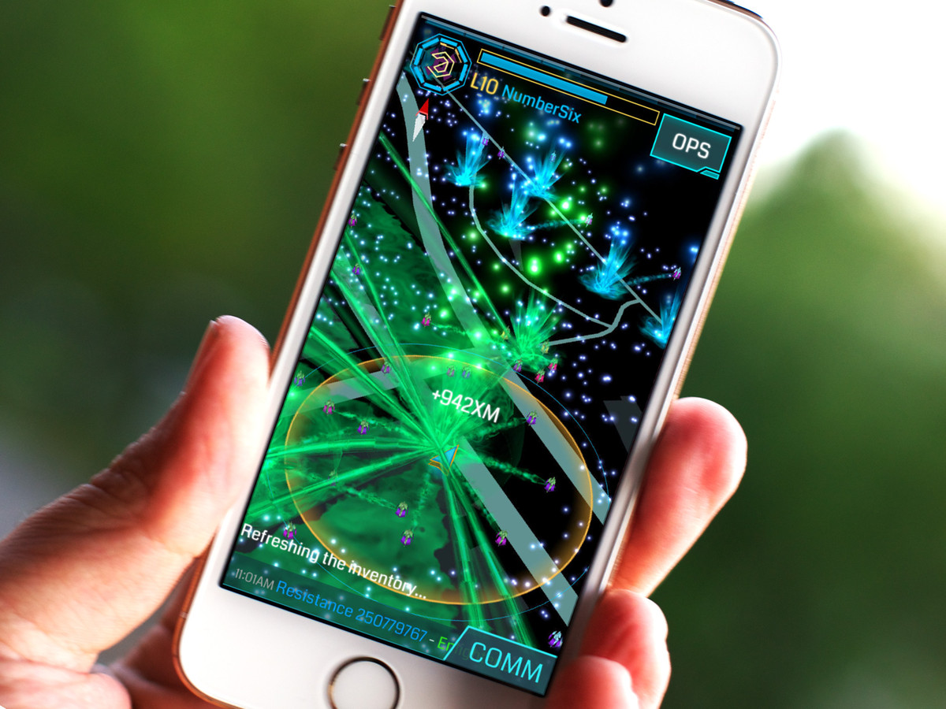
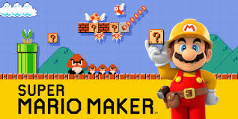
Folk Community
Companies already see players as content creators:
Ingress and Pokemon Go
Super Mario Maker

Slide 6
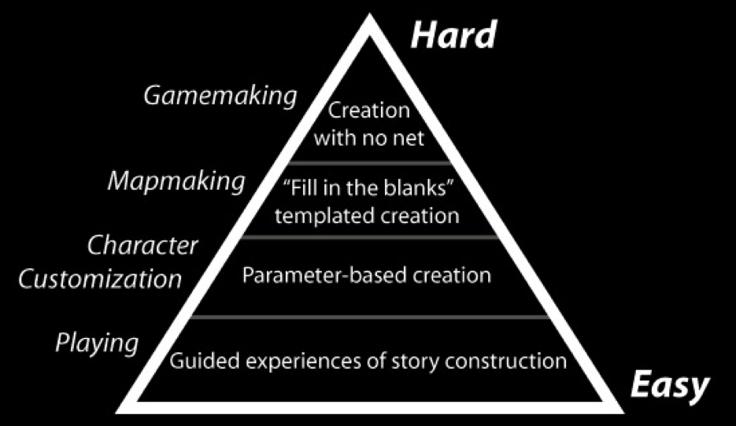

Folk Communities - Call for Inclusion
Help folks rise up the Participation Pyramid!

Slide 7
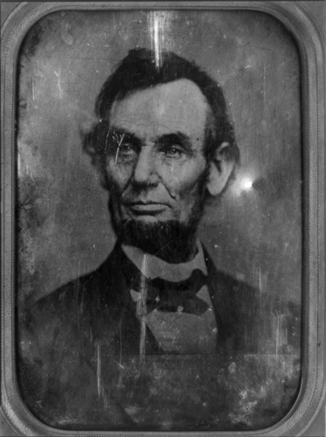
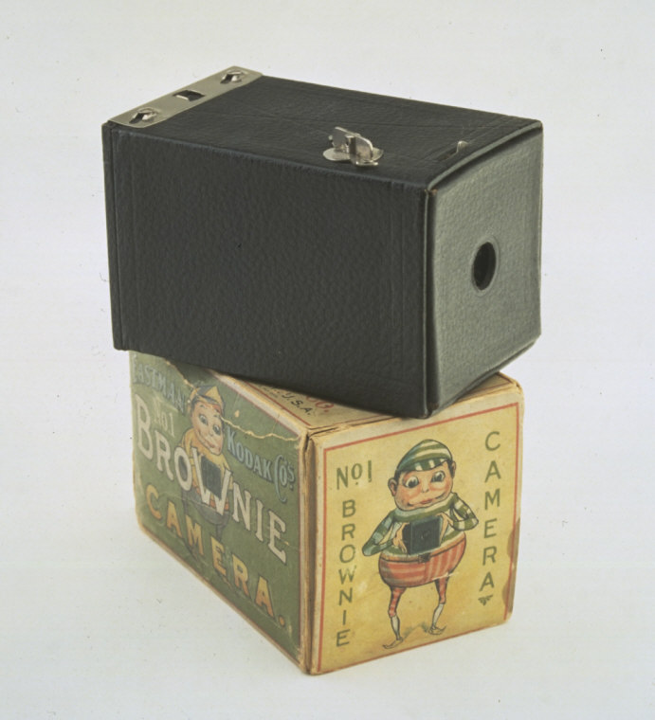


Democratization of Communication
Folk Community
Notes:
Photographic Literacy. Knowledge about the constructedness of imagery.
Technology, practice, and understanding spread from the few to the many

Slide 8
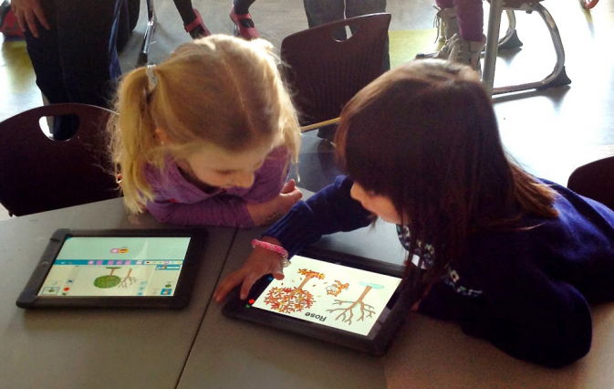
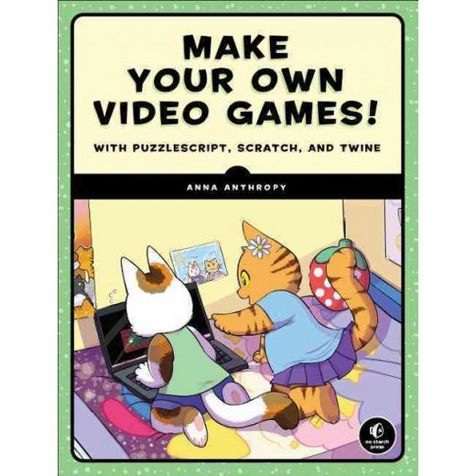

Folk Communities - Call for Inclusion
Support Games Education & Literacy

Slide 9

Folk Communities - Call for Inclusion
Support Games Education & Literacy
Audible voices and Visible bodies

Slide 10
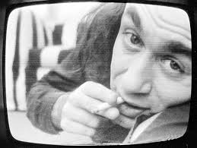

Democratization of Communication
Folk Community
Theme Song, Vito Acconci 1973
random Youtuber
Notes:
Photographic Literacy. Knowledge about the constructedness of imagery.
Technology, practice, and understanding spread from the few to the many

Slide 11
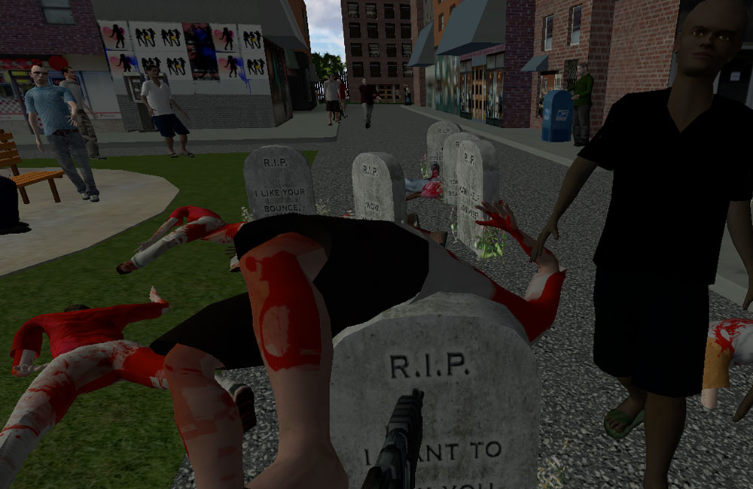
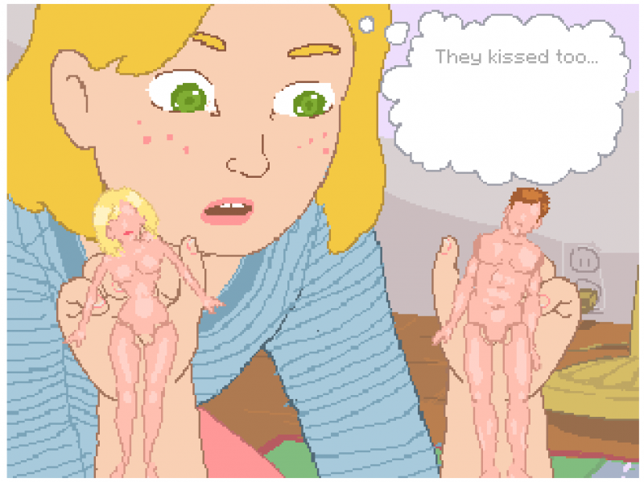
Folk Communities - Call for Inclusion
Appreciate games beyond their scope & polish
Value “Immediate Games” (Disposable is okay)
Hey Baby
How do they do it?

Slide 12

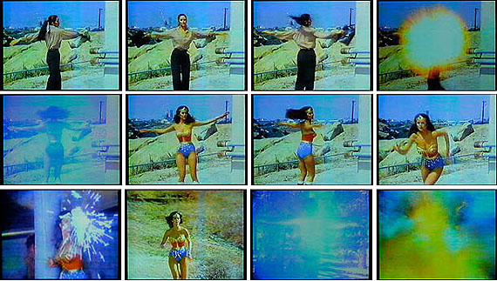
Democratization of Communication
Folk Community
Technology/Transformation: Wonder Woman,
Dara Birnbaum 1978-1979
Youtube Poop / Remix Culture
Notes:
Photographic Literacy. Knowledge about the constructedness of imagery.
Technology, practice, and understanding spread from the few to the many

Slide 13

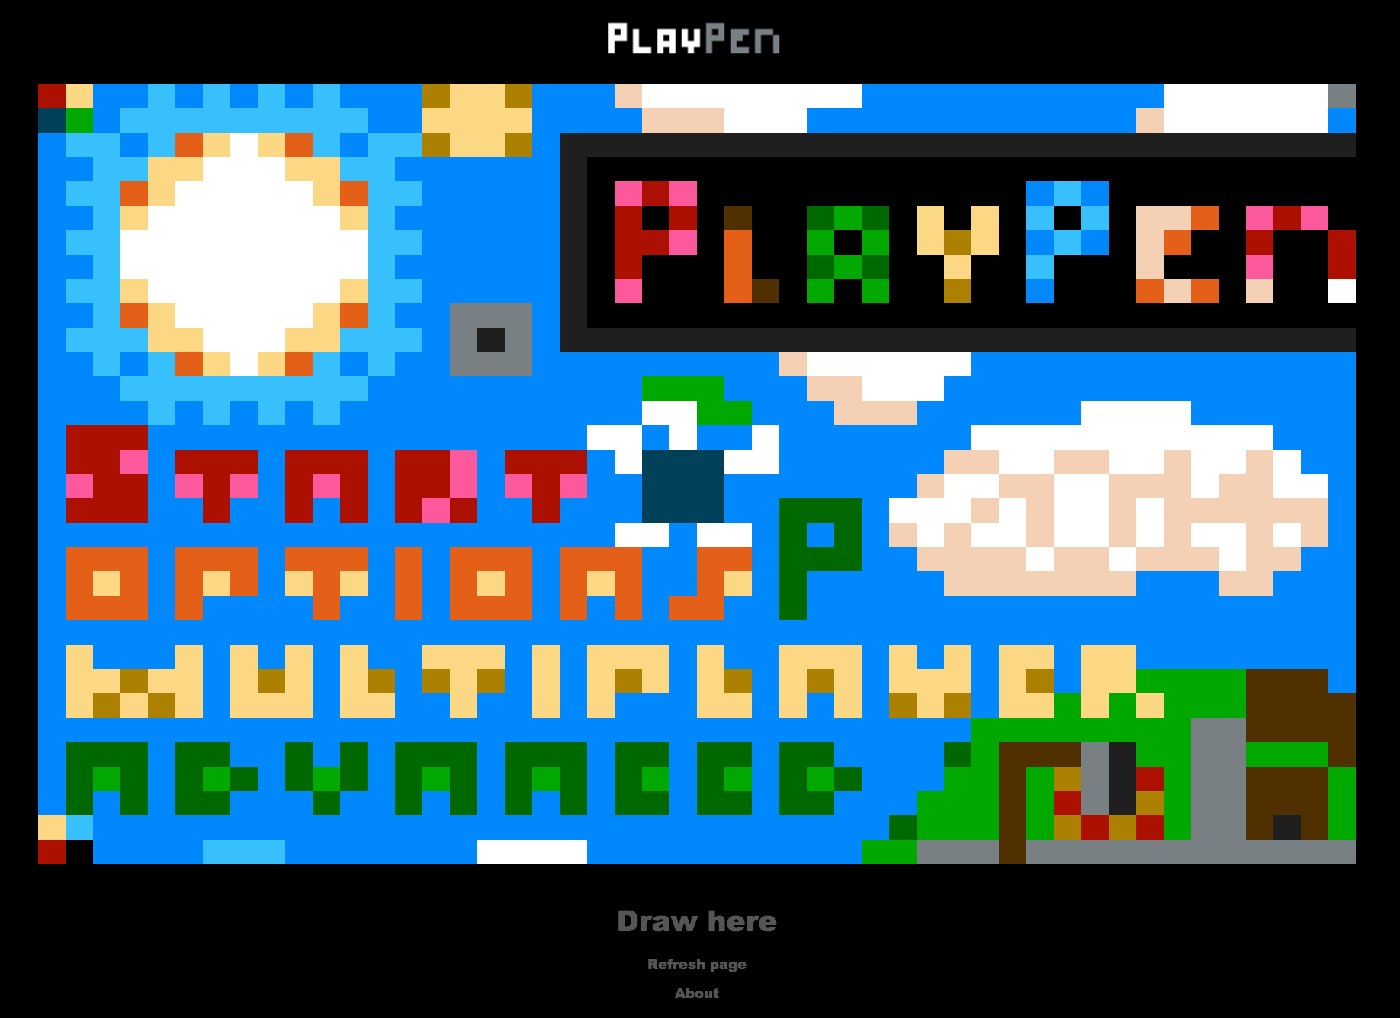

Folk Communities - Call for Inclusion
Support Crude Experimentation
  (it atomizes the medium into a language)
PlayPen

Slide 14
Overview of Game Communities
Folk
Indie
Mainstream
[Populist] High Art
High Art
Avant-garde

Slide 15

Indie Communities
Game Developer Conference (26,000 Attendees)
  Independent Games Festival
    I was 1 of 7 jurors of student prize, Grand Prize juror
  Experimental Gameplay Workshop, alt.ctrl. Train Jam

Slide 16
Indie Communities
Independent Games Festival
  Student Prize Award Criteria:
    “Overall quality”
    “Impressiveness”
    “Enjoyability”
    DePaul Game: Octodad won student category in past
    DePaul Game: That Blooming Feeling won nomination
  Grand Prize
    “overall innovation, quality, impressiveness, and enjoyability”

Slide 17
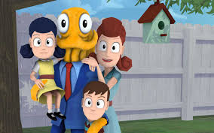
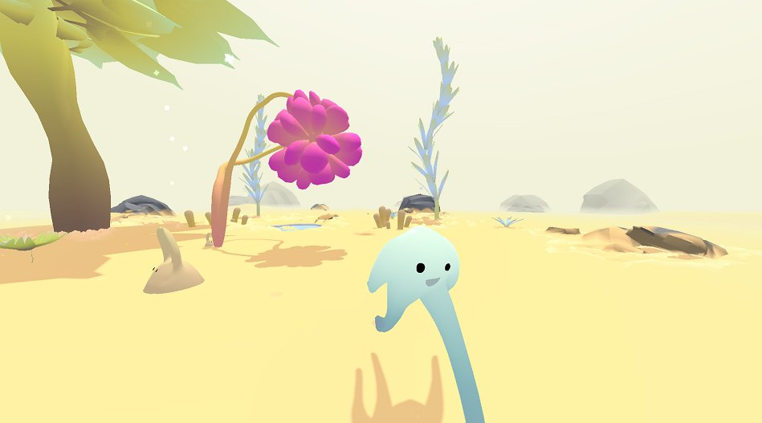
Indie Communities
Independent Games Festival
  Student Prize Award Criteria:
    “Overall quality”
    “Impressiveness”
    “Enjoyability”
    DePaul Game: Octodad won student category in past
    DePaul Game: That Blooming Feeling won nomination
  Grand Prize
    “overall innovation, quality, impressiveness, and enjoyability”

Slide 18
Indie Communities
Independent Games Festival
  Student Prize Award Criteria:
    “Overall quality”
    “Impressiveness”
    “Enjoyability”
    DePaul Game: Octodad won student category in past
    DePaul Game: That Blooming Feeling won nomination
  Grand Prize
    “overall innovation, quality, impressiveness, and enjoyability”

Slide 19
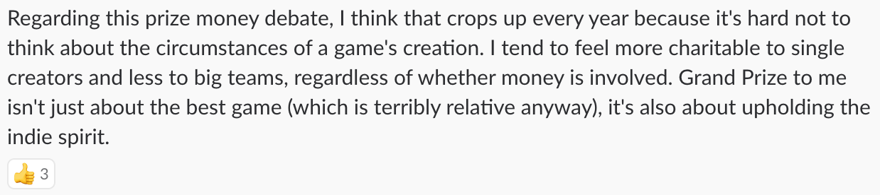
Indie Communities
Independent Games Festival
  Student Prize Award Criteria:
  Grand Prize

Slide 20
Indie Communities
Independent Games Festival
Student Prize and Grand Prize [Actual] Award Criteria:
  Broad Appeal and Polish
  Marketable Innovation
  Ready for Market
  [Are we fans of this game?]
  [Do we know the developer on Twitter?]
Proposed Award Criteria:
  Aesthetic experience (not polish)
  Under-represented Voice/Body? (not innovation)
  Open work (not whether its ready for market)

Slide 21

Indie Communities
IndieCade
~8000 Attendees
“Sundance Festival of Games”
More artistic than Independent Games Festival
Slants toward the commercial
I’ve been a juror since 2011

Slide 22
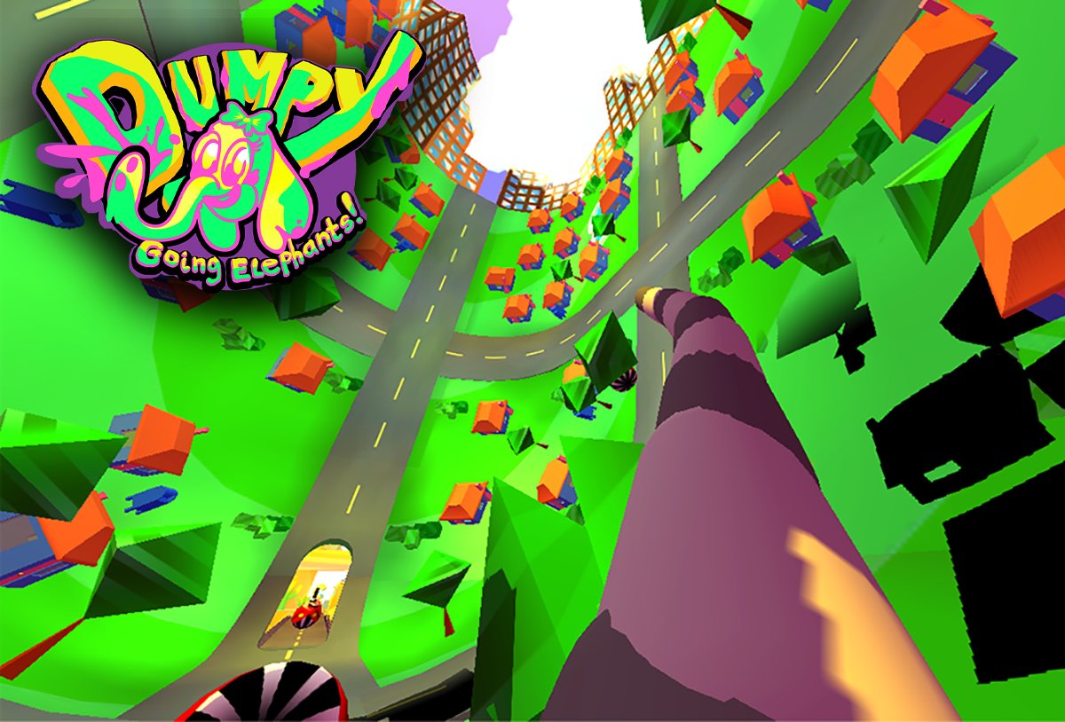
Indie Communities
IndieCade
Won award for VR Game Dumpy: Going Elephants

Slide 23

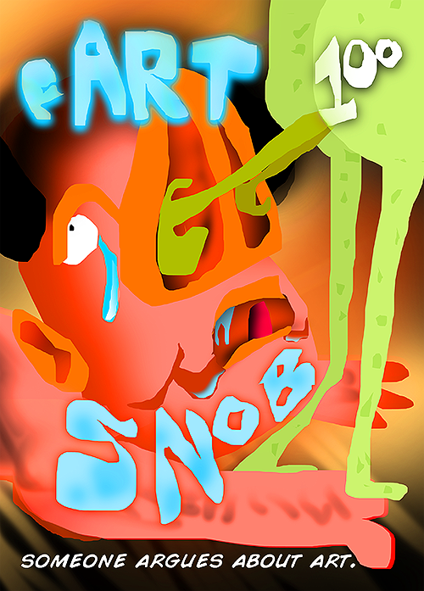
Indie Communities
IndieCade @E3
Pedandeck was rejected and then accepted

Slide 24
Indie Communities
Jury system driven by fandom. “Do I like/want to play this game?”

Slide 25
Indie Communities
“I'm having some trouble reviewing this game. It's a provocative and innovative game from someone who's clearly thought a lot about what kind of social interactions they want to provoke and exploit. It's also absolutely no fun. I didn't want to play it and I don't recommend that anyone else plays it, ever.
I don't know if that's intended - that the tension between the player and the game, which asks them to overcome a natural aversion to creating and exploiting fundamentally slightly unpleasant social situations. Unlike Cards Against Humanity, Pedandeck doesn't make the players collectively complicit in poor social behaviour in a relatively controlled way; it makes them creators and exploiters of it in the wild, and allows players to feel the social effects of their choices outside of the game, in the real world. I've never seen anything quite like it before, and I'm glad that it exists as it makes for a fascinating theoretical talking point. I just really wouldn't want to play it in future.
Materially, the components are really nicely designed, with a graffiti-art aesthetic that suits the mood of the piece perfectly.”

Slide 26
Indie Communities - Call for Inclusion
Judge not by fandom but with critical distance
Mitigate Cultural Homogenization of Games
  Adopt a multivalent composite of values explicitly stating various ways games function in culture
  Educated on history of indie entertainment and art
Proposed Award Criteria:
  Aesthetic art-entertainment experience (not polish)
  Under-represented Voice/Body? (not innovation)
Social Media Blinders
Paid in order to compensate them for their time

Slide 27
Indie Communities - Call for Inclusion
Judge not by fandom but with critical distance
Mitigate Cultural Homogenization of Games
  Adopt a multivalent composite of values explicitly stating various ways games function in culture
  Educated on history of indie entertainment and art
Proposed Award Criteria:
  Aesthetic art-entertainment experience (not polish)
  Under-represented Voice/Body? (not innovation)
Social Media Blinders
Paid in order to compensate them for their time

Slide 28
Indie Communities - Call for Inclusion
Judge not by fandom but with critical distance
Mitigate Cultural Homogenization of Games
  Adopt a multivalent composite of values explicitly stating various ways games function in culture
  Educated on history of indie entertainment and art
Proposed Award Criteria:
  Aesthetic art-entertainment experience (not polish)
  Under-represented Voice/Body? (not innovation)
Social Media Blinders
Paid in order to compensate them for their time

Slide 29
Indie Communities - Call for Inclusion
Judge not by fandom but with critical distance
Mitigate Cultural Homogenization of Games
  Adopt a multivalent composite of values explicitly stating various ways games function in culture
  Educated on history of indie entertainment and art
Proposed Award Criteria:
  Aesthetic art-entertainment experience (not polish)
  Under-represented Voice/Body? (not innovation)
Social Media Blinders
Paid in order to compensate them for their time

Slide 30
Overview of Game Communities
Folk
Indie
Mainstream
[Populist] High Art
High Art
Avant-garde

Slide 31


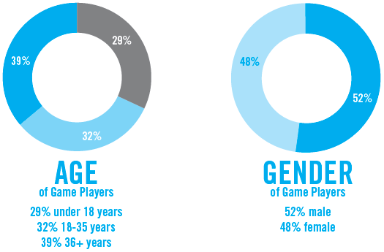
Mainstream Communities
Gamergate, #metoo, etc are watershed moments exposing widespread latent bigotry
Notes:
Due to the visibility and widespread impact of games on culture and society, there are

Slide 32
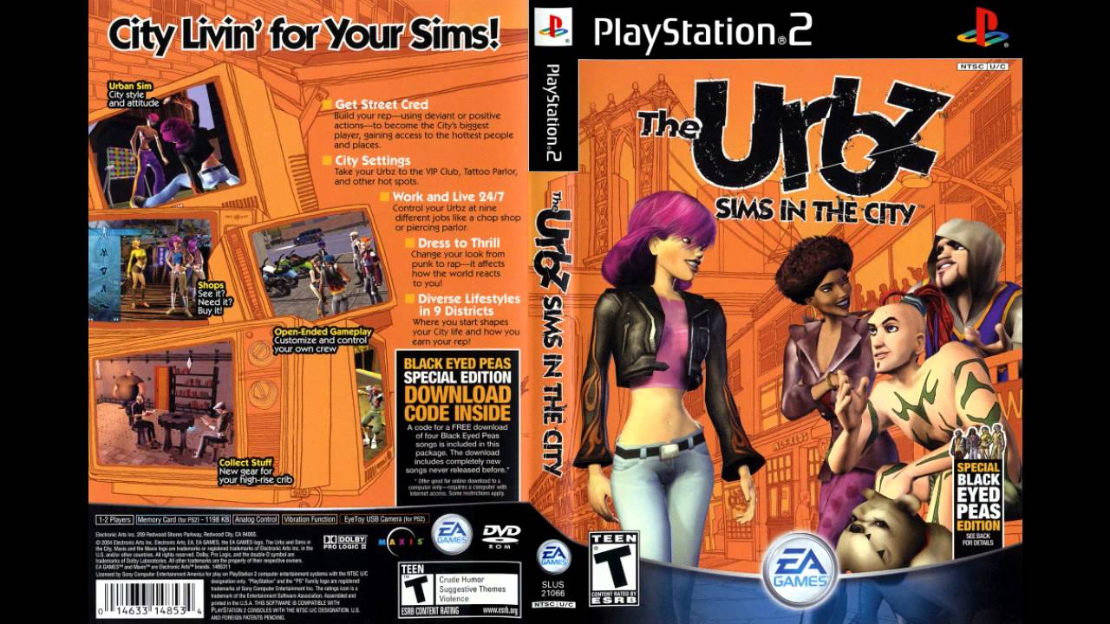
Mainstream Communities - Call for Inclusion
Worked at Electronic Arts on Urbz: Sims in the City
  Constant spiels like “the developers making games should look like the people playing them.”

Slide 33
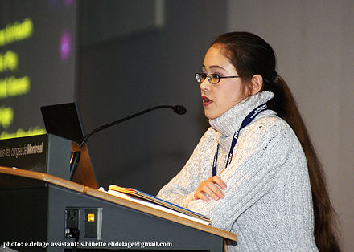
Mainstream Communities - Call for Inclusion
“EA Spouse” [Erin Hoffman’s] letter in 2004:
  “EA's turnover rate in engineering is approximately 50%. This is how EA works.”

Slide 34
Mainstream Communities - Call for Inclusion
Not 48 hour “Game Jams” but 3-week “Slow Jams”
Not “Hackathon” but “Codefest”
Not “Makerspace” but “___ Lab”

Slide 35
Overview of Game Communities
Folk
Indie
Mainstream
[Populist] High Art
High Art
Avant-garde

Slide 36
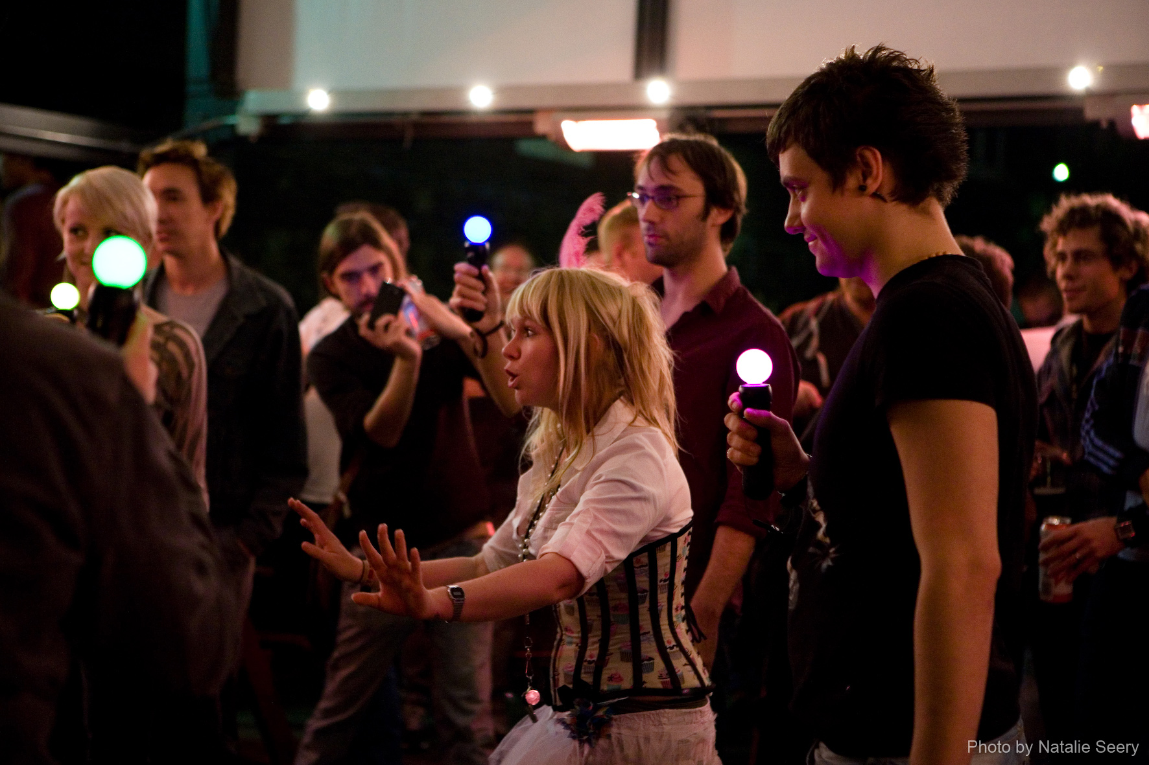

[Populist] High Art Community
Games as Art Festivals and Exhibitions
  Chicago Design Museum Exhibition (curator)
  Game folks on board wanted JS Joust, “sexy” games Videogame Art Gallery (on the board)
  Smithsonian
Award Criteria:
  Gallery-going public palatability
  Fandom lacking critical distance
  Limited understanding of art history

Slide 37
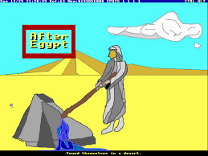
[Populist] High Art Community
Games as Art Festivals and Exhibitions
  Chicago Design Museum Exhibition (curator)
  Bit Bash (involved)
  Videogame Art Gallery (on the board)
  Smithsonian
Award Criteria:
  Gallery-going public palatability
  Fandom lacking critical distance
  Limited understanding of art history

Slide 38

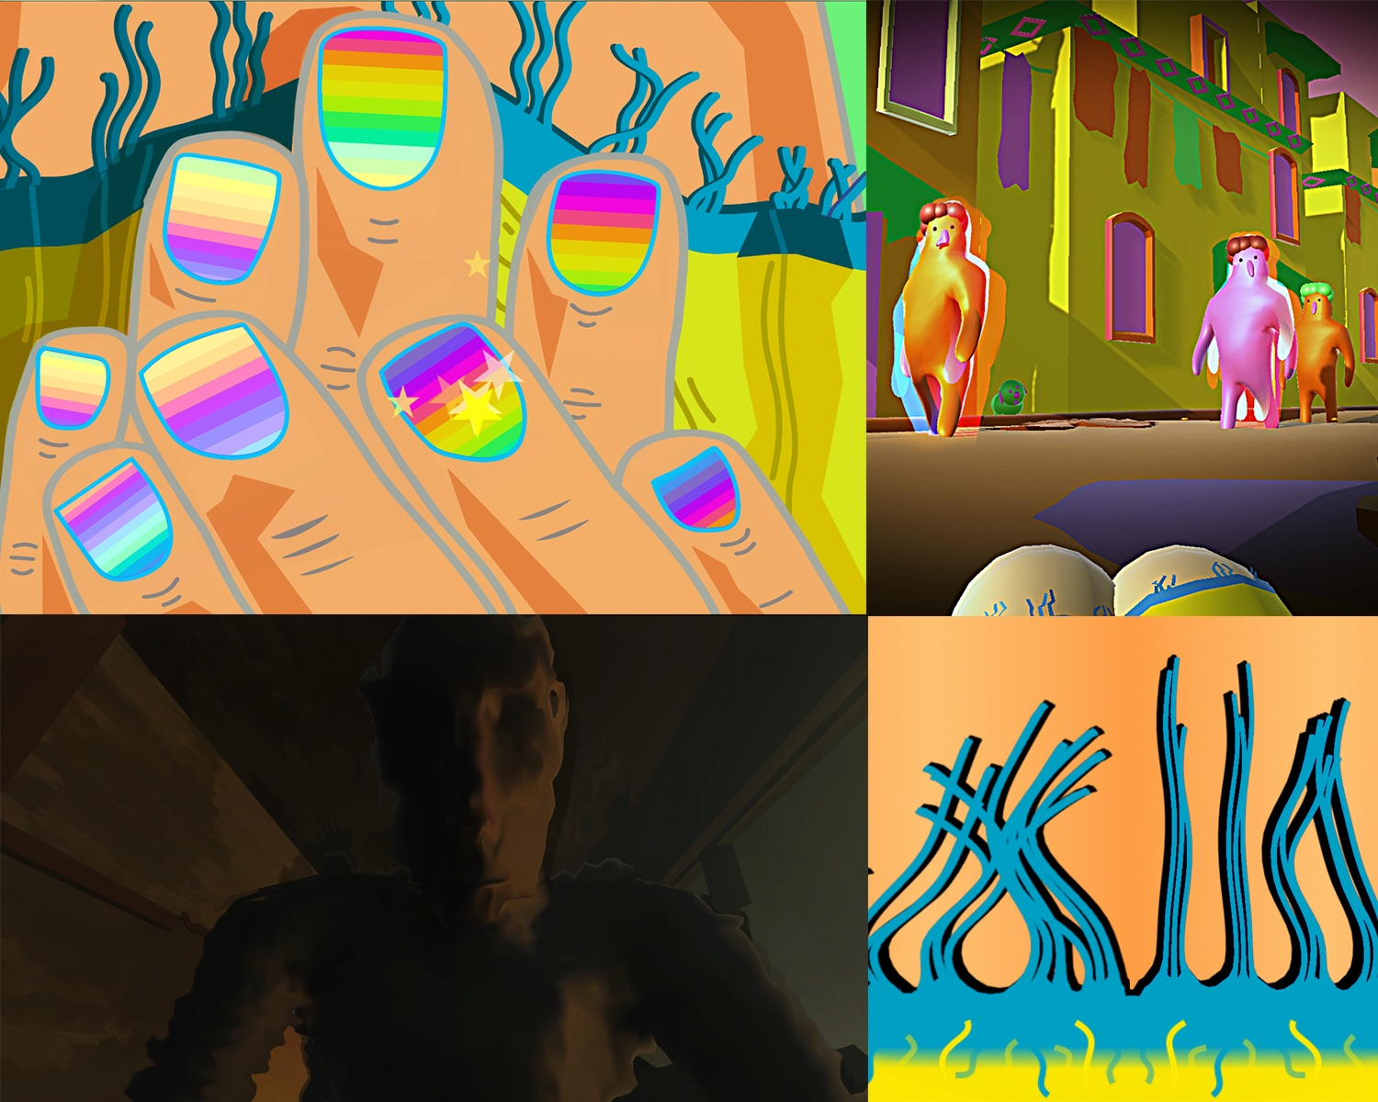
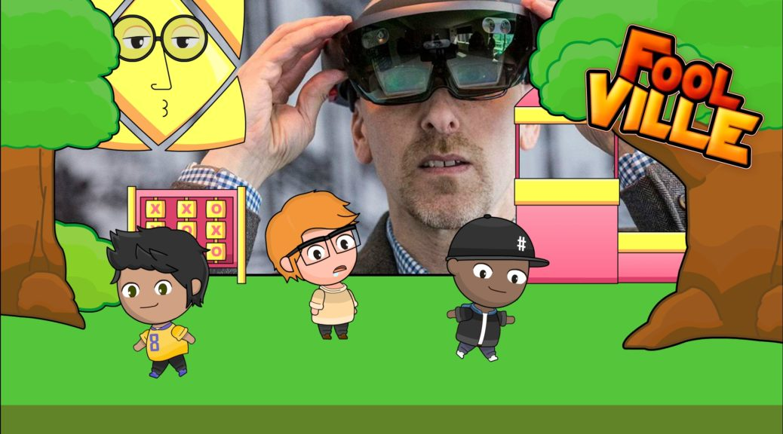
[Populist] High Art Community
Games as Art Festivals and Exhibitions
  Bit Bash (we constantly show work there)
  Videogame Art Gallery (on the board)
  Smithsonian
Award Criteria:
  Gallery-going public palatability
  Fandom lacking critical distance
  Limited understanding of art history

Slide 39
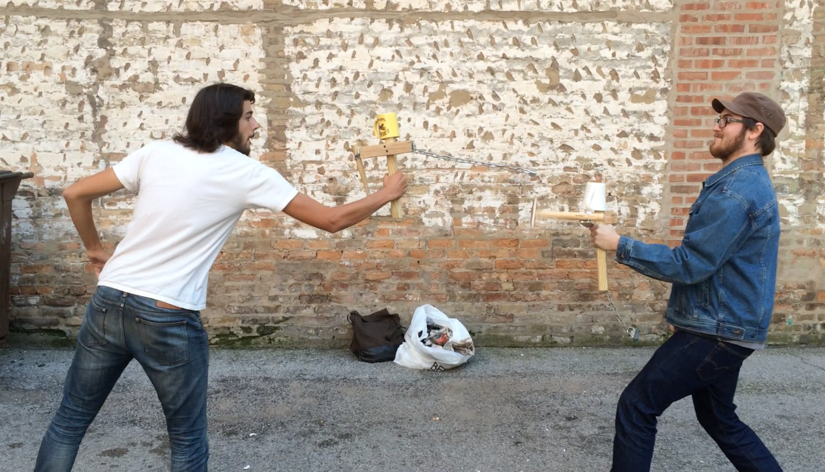
[Populist] High Art Community
Games as Art Festivals and Exhibitions
  Bit Bash values “sexy” games
  Videogame Art Gallery (on the board)
  Smithsonian
Award Criteria:
  Gallery-going public palatability
  Fandom lacking critical distance
  Limited understanding of art history
X
X

Slide 40
[Populist] High Art Community
Games Art Exhibitions [Actual] Award Criteria:
  Middlebrow palatability. “High kitsch”
  Fandom based on markets lacking critical distance
  Limited understanding of art history

Slide 41
[Populist] Communities - Call for Inclusion
Games Art Exhibitions [Actual] Award Criteria:
  Avant-garde not kitsch
  Forcework not marketability
  Aesthetic experience not polish

Slide 42
Overview of Game Communities
Folk
Indie
Mainstream
[Populist] High Art
High Art
Avant-garde

Slide 43
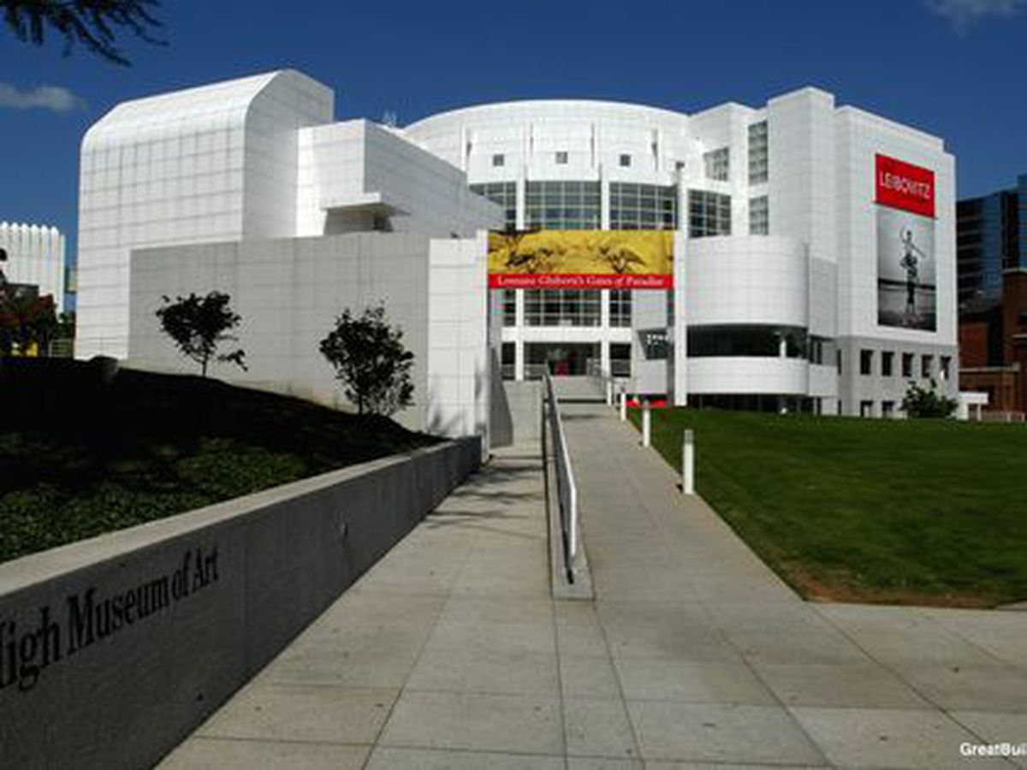

High Art Community
Spoke on Avant-garde Games at “Art History of Games” at High Museum of Art in Atlanta
Super Mario Clouds by Cory Arcangel

Slide 44
High Art Communities - Call for Inclusion
Game community doesn’t want to be “co-opted” by outsiders who don’t grind and work
Art seems irrelevant to many in the game community

Slide 45
High Art Communities - Call for Inclusion
Effort needs to be made on both sides to bring artists + game devs + musicians together
Founding a lab at DePaul called Virtual and Augmented Design Lab that will host curated game + art events targeted at above folks

Slide 46
Overview of Game Communities
Folk
Indie
Mainstream
[Populist] High Art
High Art
Avant-garde

Slide 47
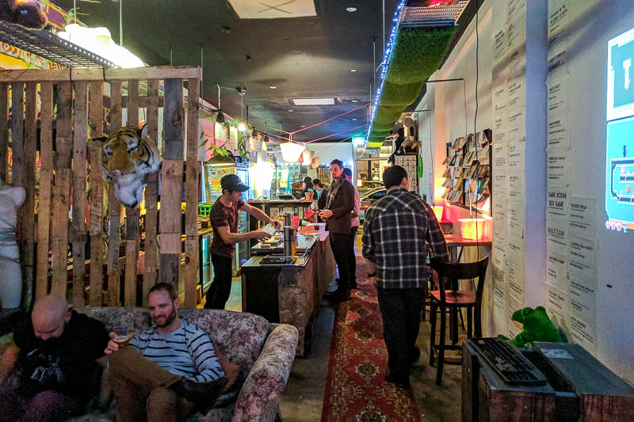
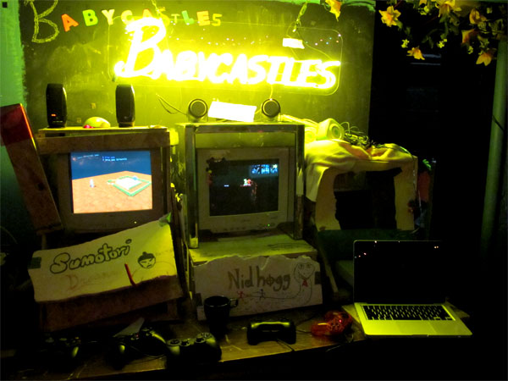
Avant-garde Communities
Babycastles in New York
Bar SK in Melbourne
D.A.D.S. in Chicago
…
Seem to value
Glitch art arising from an “anti-aesthetic” arising after postmodernism
Gritty, inebriated social comfort in end times

Slide 48
Avant-garde Communities
Babycastles in New York
Bar SK in Melbourne
D.A.D.S. in Chicago
…
Seem to value
Glitch art arising from an “anti-aesthetic” arising after postmodernism
Gritty, inebriated social comfort in end times

Slide 49
Avant-garde Communities - Call for Inclusion
Go beyond digital neo-grunge and cater to more socially awkward folks
Value a range of diverse themes and vibes. Change the aesthetic to draw in new people

Slide 50
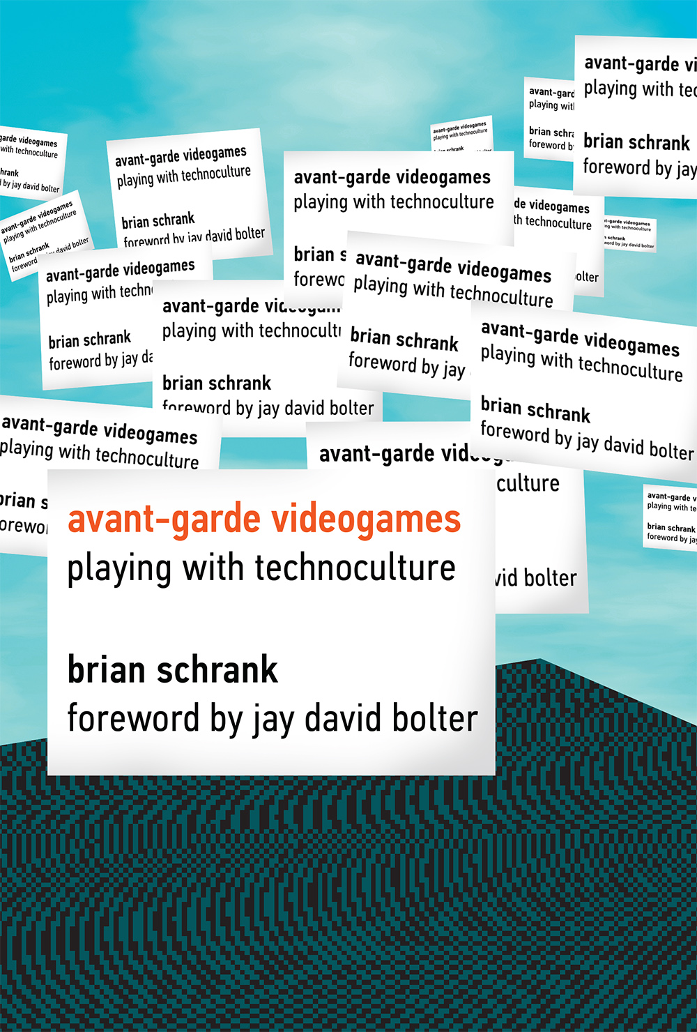
Avant-garde Communities - Call for Inclusion
Beatrice Hale described the feminist struggle using the “metaphor of an army to delineate the main body of parliamentary suffragists, the rear of municipal suffragists, a vanguard of 'advanced feminists', and an ultra-radical group of 'skirmishers'.”
No more liberal purity tests.

Slide 51
Avant-garde Communities - Call for Inclusion
Beatrice Hale described the feminist struggle using the “metaphor of an army to delineate the main body of parliamentary suffragists, the rear of municipal suffragists, a vanguard of 'advanced feminists', and an ultra-radical group of 'skirmishers'.”
No more purity tests.

Slide 52
Thank you!
Questions? Comments? www.BrianSchrank.com bschrank@gmail.com twitter: @brianschrank instagram: @inflatable_reality

